Slide 1
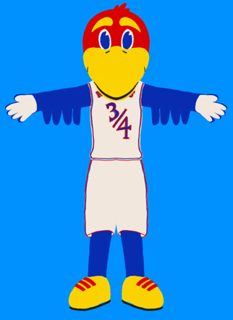

Junior Jay
Scott | Jake | Luke | Josh

Slide 2
MOTIVATION
Fostering School Spirit and Engagement:
Animating the Jayhawks mascot to energize events, strengthen community bonds, and boost university pride.
Interdisciplinary Learning and Innovation:
Offering hands-on experience in cutting-edge technology, promoting collaboration across fields, and showcasing KU's commitment to technological advancement.
Enhancing Branding and Entertainment:
Utilizing the animatronic head as a unique attraction to elevate KU's brand presence and provide captivating entertainment at various functions.

Slide 3
TECHNICAL OBJECTIVES
The project's core objective is to upgrade a non-functional baby jay head with animatronics, illustrating the potential of such technology through articulated movements of eyebrows, eyelids, and the beak. The mechanical engineering team's responsibilities include developing the structural and mechanical aspects of these features, ensuring their seamless operation, and integrating all hardware components effectively. They are pivotal in achieving the mechanical fidelity and durability required for the animatronics to function as intended.
Parallelly, the electrical and computer engineering team is focused on the electronic and software facets, designing custom PCBs, managing power systems, and implementing software that harnesses facial recognition technology to animate the features realistically. Their work is crucial in establishing the interactive capabilities of the animatronic head, providing the technical backbone for its operation, and demonstrating the application of sophisticated engineering principles to create responsive and lifelike animatronic expressions.

Slide 4
TECHNICAL APPROACH
1. Design and Conceptualization:
Our main focus these first 8 weeks have been on embodiment and configuration design regarding prototypes and testing.
The internal framework incorporates servo motors for precise, subtle movements and pneumatic systems for broader, more impactful actions. This structure ensures an optimal balance between weight distribution and motion range, facilitating realistic head turns and expressions.
We used design software and simulation tools such as ADAMS, SolidWorks, and Fusion 360 used to model and refine the animatronic head.
2. Mechatronics and Control Systems:
We’ve sought to find:
Description of the integration of mechanical, electronic, and computer engineering in developing the animatronics control system.
Explanation of the actuators, sensors, and controllers used to animate the Jayhawks head, including how they interact to achieve lifelike movements.
3. Enhanced Computational Power:
By choosing a co-processor-based system, we leverage additional computational resources to handle complex algorithms and real-time processing, essential for delivering nuanced and dynamic animatronic movements.
The software is specifically programmed to decode intricate motion sequence files, which detail the positional, rotational, and timing information for each animatronic component, ensuring precise execution of pre-designed movements.
4. Materials and Fabrication:
Used advanced 3D printing methods to create precise and complex internal frameworks, so we can manufacture metal components for the final design to ensure reliability

Slide 5
PROGRESS OVERVIEW
We been at work making CAD models, printing, and testing our mechanisms for the three systems each week.
Lower Beak Actuation - Decided to switch to direct servo mount after meeting w/machine shop
Eyebrow Actuation - Successfully tested three-bar linkage controlled by two servos
Eyelid Actuation - Initial proof of concept went well. Refining design changes. Final design will incorporate vacuum formed eyes and a aluminum frame.

Slide 6


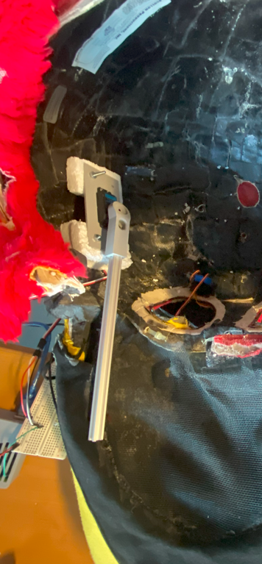
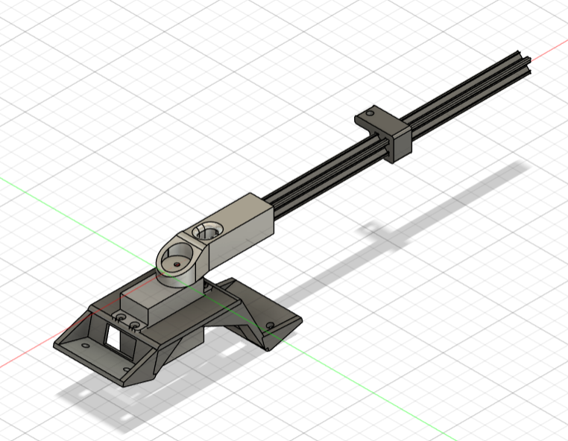
LOWER BEAK PROGRESS
Met with Charles in the ME machine shop. After meeting, we determined to put the old cam concept on hold.
Designed new part that connects AL extrusion directly to the servo, plus new mount to attach to the head.
Tried testing servo, but not giving enough torque to lift weight of beak. Possibly an electrical issue, will need to discuss with EE team about voltage/current supply to the servo.

Slide 7
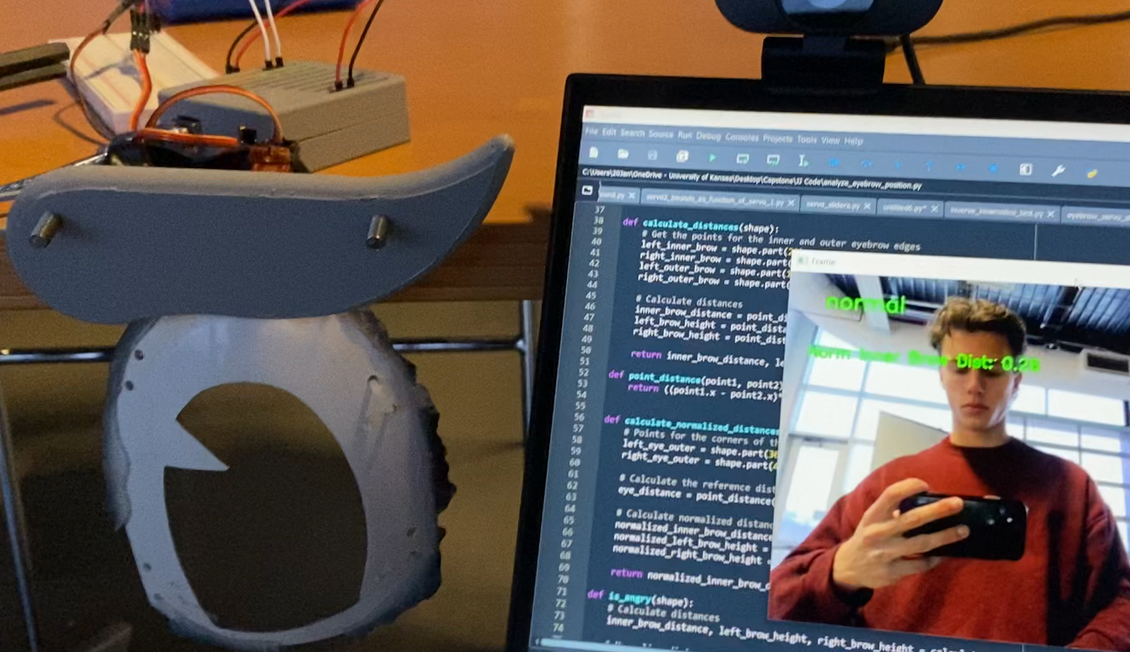


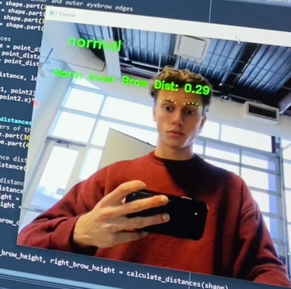
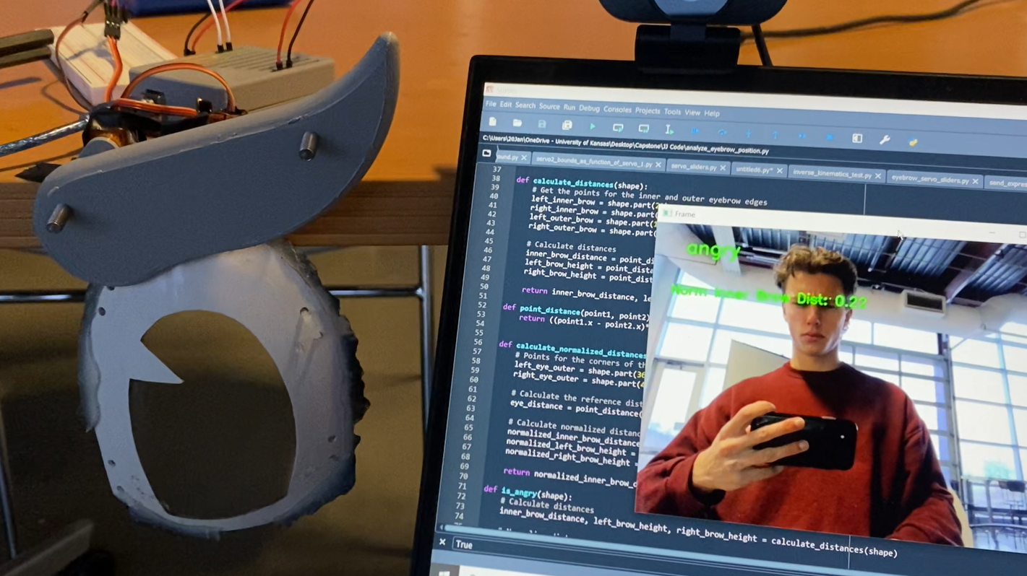
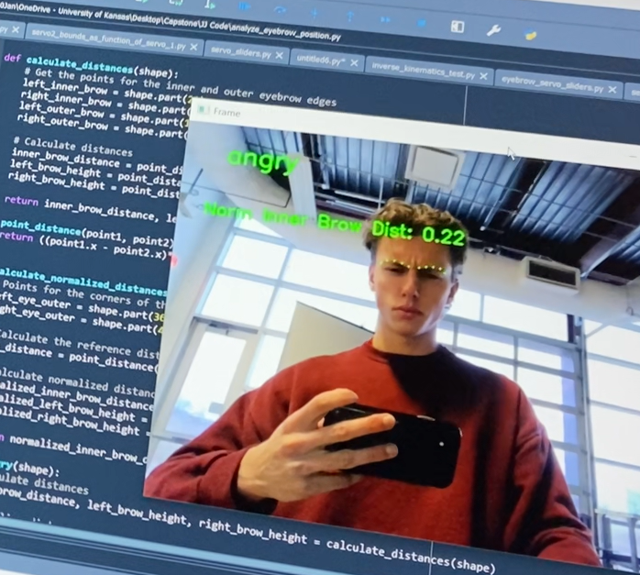
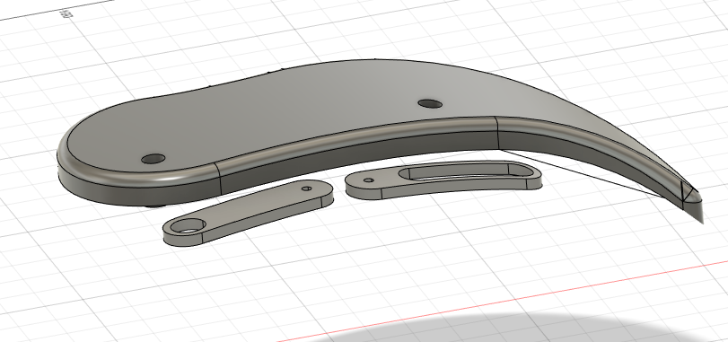
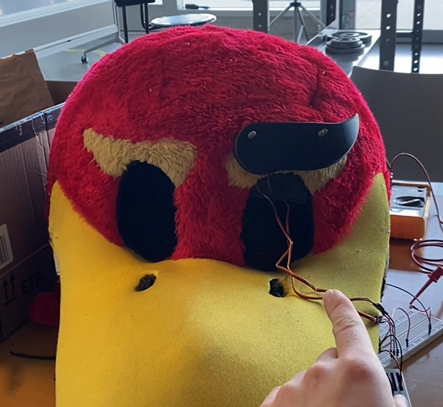
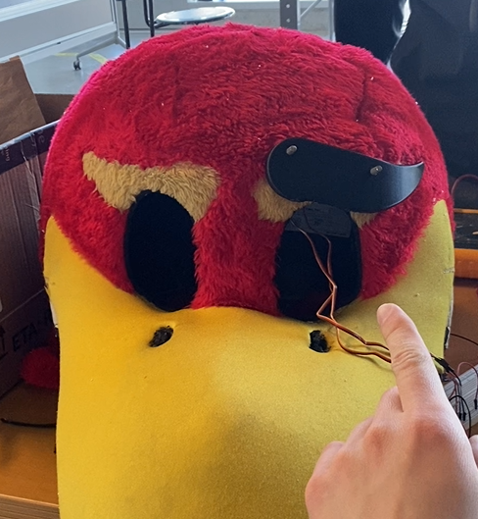
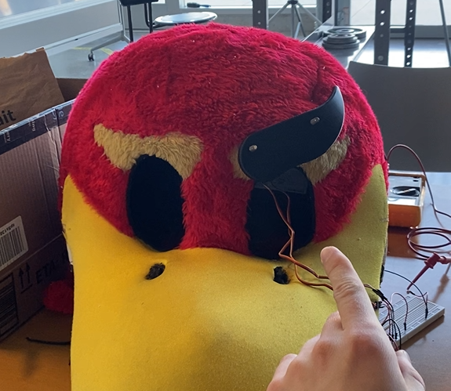
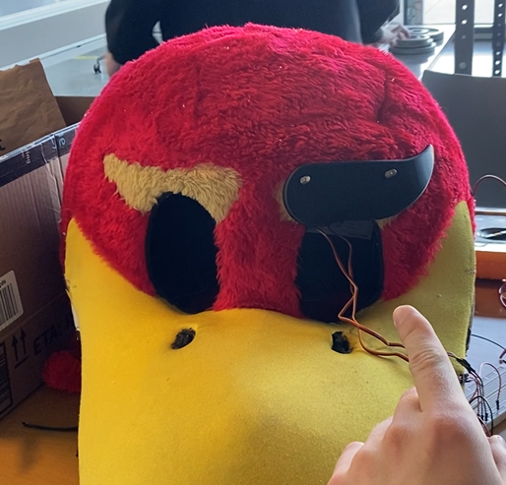
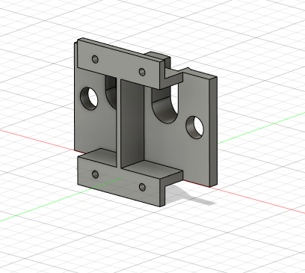
EYEBROW PROGRESS
Successfully installed right eyebrow, tested by manually setting servo positions
Wrote python script using computer vision to detect my expression as “normal” or “angry” depending on distance between facial feature points
In future, will need to coordinate with EECS team to complete rest of expression detection and make sure program is robust, works in low light, and in close quarters
Inner-brow distance determines expression
surprised
worried
angry
normal

Slide 8


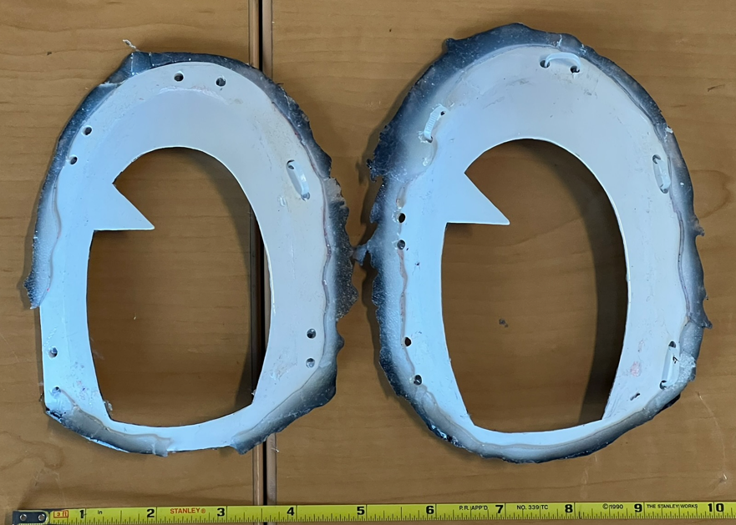
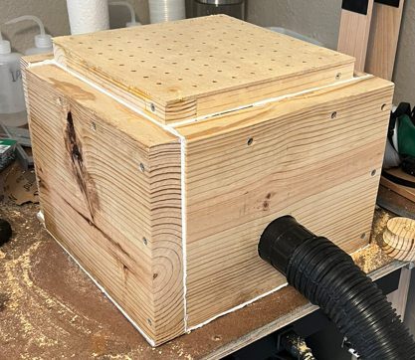
EYELID PROGRESS
The older eye model featured a blue mesh iris and white sections made of hard plastic with jagged, sharp edges. The updated eyes will be crafted using a seamless, vacuum-formed design where blue blends into white, eliminating material transitions. This improvement ensures that the fabric eyelids glide smoothly across the eyes without snagging.
On March 8, 2024, we plan to test the mechanism, which integrates a DC motor that shares voltage compatibility with the existing servos. This motor will drive a timing belt, controlling the movement of a fabric eyelid. The eyelid's motion halts upon contacting a limit switch, activated by a slender 2mm diameter metal bar at the eyelid's base.
Old eyes (Top) Vacuum Forming Machine (Bottom)

